Slide 1
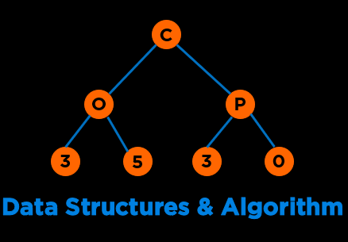
Trees
Notes:
Hi everyone, welcome to the second module of the course

Slide 2

Categories of Data Structures
Linear Ordered
Non-linear Ordered
Not Ordered
Lists
Trees
Sets
Stacks
Graphs
Tables/Maps
Queues
Notes:
Data structures are ways to collect data. There are basic categories of data structures:

Slide 3


Trees
A tree is a rooted, directed, acyclic structure. It has three properties: one root; each node has one parent; and no cycles.
25
2
15
51
5
11
65
Notes:
Data structures are ways to collect data. There are basic categories of data structures:

Slide 4

Use Cases
Family Trees
Decision Trees
File Systems
Expression Trees
Search Trees
https://commons.wikimedia.org/wiki/File:Black_family_tapestry_as_seen_at_Harry_Potter_Experience.jpg
/
root
bin
var
etc
media
image
video
audio
document
Notes:
Data structures are ways to collect data. There are basic categories of data structures:

Slide 5
Tree Terminology
Notes:
Hi everyone, welcome to the second module of the course

Slide 6
Trees: Terminology
Root
The node at the top is called the root.
25
Root
2
51
5
11
14
65
Notes:
Data structures are ways to collect data. There are basic categories of data structures:

Slide 7
Trees: Terminology
Children
Successors of a node are called children.
25
Child of 25
Child of 25
2
51
Child of 2
Child of 51
5
11
14
65
Notes:
Data structures are ways to collect data. There are basic categories of data structures:

Slide 8
Trees: Terminology
Parent
Predecessors of a node are called parent.
25
Parent of 2, 51
2
51
Parent of 14, 65
Every child has one parent
except the root. Root has no
parents.
5
11
14
65
Notes:
Data structures are ways to collect data. There are basic categories of data structures:

Slide 9
Trees: Terminology
Grandparent
Predecessors of a node’s parent are called grandparent.
25
Grandparent of 14, 65, 5, 11
2
51
5
11
14
65
Notes:
Data structures are ways to collect data. There are basic categories of data structures:

Slide 10
Trees: Terminology
Sibling
All nodes that have the same parent node are siblings.
25
2
51
2, 51 are siblings
5
11
14
65
Notes:
Data structures are ways to collect data. There are basic categories of data structures:

Slide 11
Trees: Terminology
Ancestor
All nodes that can be reached by moving only in an upward direction in the tree.
25
2
51
25, 51 are ancestors of 14
5
11
14
65
Notes:
Data structures are ways to collect data. There are basic categories of data structures:

Slide 12
Trees: Terminology
Descendent
Nodes that can be reached by moving only in a downward direction in the tree.
25
2
51
14 is a descendant of 25 and 51
5
11
14
65
Notes:
Data structures are ways to collect data. There are basic categories of data structures:

Slide 13
Trees: Terminology
Leaf
Nodes with no children are called leaf nodes or external nodes.
25
Non-leaf nodes are also called internal nodes. 25, 51, 2 are internal nodes.
2
51
5
11
14
65
5, 11, 14, 65 are Leaf Nodes
Notes:
Data structures are ways to collect data. There are basic categories of data structures:

Slide 14
Trees: Terminology
Subtree
A subtree of a node is a tree whose root is a child of that node.
25
Subtrees of 25
2
51
5
11
65
Notes:
Data structures are ways to collect data. There are basic categories of data structures:

Slide 15
Trees: Terminology
Level (Depth)
The level of a node is the distance of that node from the root.
Level 0
25
If node n is root,
Level(n) = 0
2
51
If node n is not a root,
Level(n) = level(parent) + 1
Level 1
Level 2
5
11
14
65
Notes:
Data structures are ways to collect data. There are basic categories of data structures:

Slide 16
Trees: Terminology
Height – 0 based height (based on edges)
The height of a tree is the number of nodes in the longest path from the root node to a leaf node
25
Height = 2
If tree has just the root,
Height = 0
2
51
If tree has more than the root,
Height = 1 + max(Height(children))
14
65
https://stackoverflow.com/questions/4065439/height-of-a-tree-with-only-one-node
Notes:
Data structures are ways to collect data. There are basic categories of data structures:

Slide 17
Trees: Terminology
Height – 1 based height (based on nodes)
The height of a tree is the number of nodes in the longest path from the root node to a leaf node
25
Height = 3
If tree has just the root,
Height = 1
2
51
If tree has more than the root,
Height = 1 + max(Height(children))
14
65
https://stackoverflow.com/questions/4065439/height-of-a-tree-with-only-one-node
Notes:
Data structures are ways to collect data. There are basic categories of data structures:

Slide 18
Tree Types
Notes:
Hi everyone, welcome to the second module of the course

Slide 19
Trees: Type
N-Ary Tree
A tree with each node consisting of at most n children.
Tree has three properties: one root; each node has one parent; and no cycles.
25
2
51
… n …
5
11
14
65
… n …
… n …
Notes:
Data structures are ways to collect data. There are basic categories of data structures:

Slide 20
Trees: Type
Binary Tree
A tree with each node consisting of at most two children.
25
2
51
11
65
Notes:
Data structures are ways to collect data. There are basic categories of data structures:

Slide 21
Trees: Type
Full Binary Tree
A full binary tree is a binary tree where all nodes have either 2 children or 0 children (the leaf nodes)
25
2
51
5
11
5
11
Notes:
Data structures are ways to collect data. There are basic categories of data structures:

Slide 22
Trees: Type
Perfect Binary Tree
A perfect binary tree is a full binary tree of height h with exactly 2^{h+1} – 1 nodes. Here, h is 0-based (height of a tree with one node is 0).
In a perfect binary tree with n nodes, the height of the tree is log₂ (n+1) - 1.
25
2
51
5
11
14
65
h = 2 and 2^{h+1} – 1 = 7
n = 7 and log₂ (7+1) - 1 = 2
Notes:
Data structures are ways to collect data. There are basic categories of data structures:

Slide 23
Trees: Type
Complete Binary Tree
A complete binary tree is a perfect binary tree through level h - 1 with some extra leaf nodes at level h (the tree height), all towards the left
The height of a complete binary tree is also ceil(log₂ (n+1) - 1)
25
2
51
5
11
14
Is a full tree complete? Is a complete tree full?
Notes:
Data structures are ways to collect data. There are basic categories of data structures:

Slide 24
Trees: Type
Binary Search Tree (BST)
A binary tree in which all values of a node’s left subtree or descendants to the left are less than the node and all values of a node’s right subtree are greater than the node.
An ordered binary tree.
25
12
51
5
14
34
Notes:
Data structures are ways to collect data. There are basic categories of data structures:

Slide 25
Trees Representation
Notes:
Hi everyone, welcome to the second module of the course

Slide 26
Trees: Representation
Notes:
Data structures are ways to collect data. There are basic categories of data structures:

Slide 27

Trees: Representation
Parent, i
Child, 2i, 2i+1
1
25
Array Representation
2
3
2
51
Tree[]
25
2
51
14
65
0
5
10
6
7
14
65
Notes:
Data structures are ways to collect data. There are basic categories of data structures:

Slide 28

Trees: Representation
Parent, i
Child, 2i, 2i+1
1
25
Array Representation
2
3
2
51
Tree[]
25
2
51
14
65
0
5
10
6
7
Linked Representation
14
65
class TreeNode
{
public:
int val;
TreeNode *left;
TreeNode *right;
TreeNode(int x) : val(x), left(nullptr), right(nullptr) {}
};
Notes:
Data structures are ways to collect data. There are basic categories of data structures:

Slide 29
Binary Search Trees
Notes:
Hi everyone, welcome to the second module of the course

Slide 30
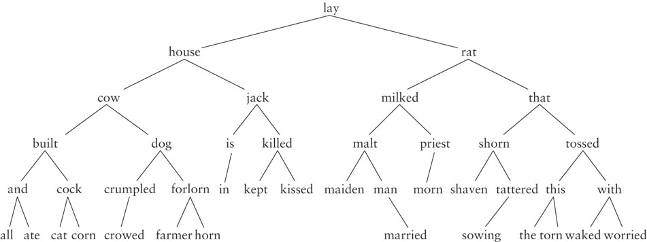
Binary Search Tree (BST): Dictionary
Notes:
Data structures are ways to collect data. There are basic categories of data structures:

Slide 31
Binary Search Tree: C++ Node Class
class TreeNode
{
public:
int val;
TreeNode *left;
TreeNode *right;
TreeNode(int x) : val(x), left(nullptr), right(nullptr) {}
};
https://onlinegdb.com/BygDgQCjI
Notes:
Track of progress, access to current and mechanism to next data element
Dereference operator to get the data

Slide 32
Binary Search Tree Search
25
12
51
5
14
34
Notes:
Data structures are ways to collect data. There are basic categories of data structures:

Slide 33
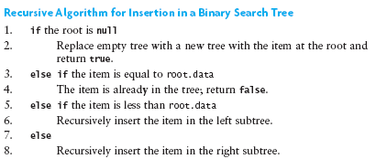
Binary Search Tree Insertion
25
12
51
5
14
34
Notes:
Data structures are ways to collect data. There are basic categories of data structures:

Slide 34
Binary Search Tree: C++ Insert
class TreeNode
{
public:
int val;
TreeNode *left;
TreeNode *right;
TreeNode(int x) : val(x), left(nullptr), right(nullptr) {}
};
TreeNode* insert(TreeNode* root, int key)
{
if (root == nullptr)
return new TreeNode(key);
if (key < root->val)
root->left = insert(root->left, key);
else
root->right = insert(root->right, key);
return root;
}
https://onlinegdb.com/BygDgQCjI
Notes:
Track of progress, access to current and mechanism to next data element
Dereference operator to get the data

Slide 35
Binary Search Tree: C++ Insert Example
Insert 15
25
12
51
5
14
34
TreeNode* insert(TreeNode* root, int key)
{
if (root == nullptr)
return new TreeNode(key);
if (key < root->val)
root->left = insert(root->left, key);
else
root->right = insert(root->right, key);
return root;
}
insert(root₂₅, 15)
https://onlinegdb.com/BygDgQCjI
Notes:
Track of progress, access to current and mechanism to next data element
Dereference operator to get the data

Slide 36
Binary Search Tree: C++ Insert Example
Insert 15
25
12
51
TreeNode* insert(TreeNode* root, int key)
{
if (root == nullptr)
return new TreeNode(key);
if (key < root->val)
root->left = insert(root->left, key);
else
root->right = insert(root->right, key);
return root;
}
insert(root₁₂, 15)
5
14
34
TreeNode* insert(TreeNode* root, int key)
{
if (root == nullptr)
return new TreeNode(key);
if (key < root->val)
root->left = insert(root->left, key);
else
root->right = insert(root->right, key);
return root;
}
insert(root₂₅, 15)
https://onlinegdb.com/BygDgQCjI
Notes:
Track of progress, access to current and mechanism to next data element
Dereference operator to get the data

Slide 37
Binary Search Tree: C++ Insert Example
Insert 15
25
TreeNode* insert(TreeNode* root, int key)
{
if (root == nullptr)
return new TreeNode(key);
if (key < root->val)
root->left = insert(root->left, key);
else
root->right = insert(root->right, key);
return root;
}
insert(root₁₄, 15)
12
51
TreeNode* insert(TreeNode* root, int key)
{
if (root == nullptr)
return new TreeNode(key);
if (key < root->val)
root->left = insert(root->left, key);
else
root->right = insert(root->right, key);
return root;
}
insert(root₁₂, 15)
5
14
34
TreeNode* insert(TreeNode* root, int key)
{
if (root == nullptr)
return new TreeNode(key);
if (key < root->val)
root->left = insert(root->left, key);
else
root->right = insert(root->right, key);
return root;
}
insert(root₂₅, 15)
https://onlinegdb.com/BygDgQCjI
Notes:
Track of progress, access to current and mechanism to next data element
Dereference operator to get the data

Slide 38
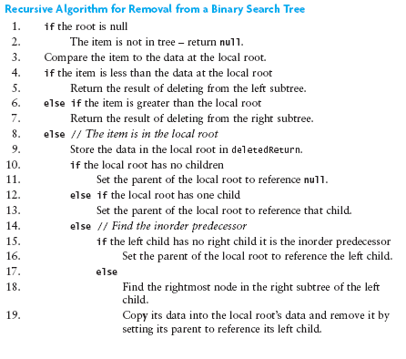
Binary Search Tree Deletion
25
12
51
5
14
34
Notes:
Data structures are ways to collect data. There are basic categories of data structures:

Slide 39
Binary Search Tree Deletion: Example
25
Delete 14: No child
12
51
5
14
34
Notes:
Data structures are ways to collect data. There are basic categories of data structures:

Slide 40
Binary Search Tree Deletion: Example
25
Delete 14: No child
At the parent of 14, set the child with value 14 to null.
12
51
25
5
14
34
12
51
5
34
Notes:
Data structures are ways to collect data. There are basic categories of data structures:

Slide 41
Binary Search Tree Deletion: Example
25
Delete 51: One child
12
51
5
34
Notes:
Data structures are ways to collect data. There are basic categories of data structures:

Slide 42
Binary Search Tree Deletion: Example
25
Delete 51: One child
At the parent of 51, set the pointer with the child value 51 to the pointer of the node 51’s child.
12
51
25
5
34
12
34
5
Notes:
Data structures are ways to collect data. There are basic categories of data structures:

Slide 43
Binary Search Tree Deletion: Example
25
Delete 25: Two children
12
34
5
30
32
Notes:
Data structures are ways to collect data. There are basic categories of data structures:

Slide 44
Binary Search Tree Deletion: Example
25
Delete 25: Two children
Change the value of the node to be deleted to the value of inorder successor or predecessor. Then delete the successor or predecessor value at the subtree.
12
34
5
30
32
Notes:
Data structures are ways to collect data. There are basic categories of data structures:

Slide 45
Binary Search Tree Deletion: Example
25
Delete 25: Two children
Change the value of the node to be deleted to the value of inorder successor or predecessor. Then delete the successor or predecessor value at the subtree.
12
34
5
30
Successor: right subtree’s leftmost child
Predecessor: left subtree’s rightmost child
32
Notes:
Data structures are ways to collect data. There are basic categories of data structures:

Slide 46
Binary Search Tree Deletion: Example
25
Delete 25: Two children
Change the value of the node to be deleted to the value of inorder successor. Then delete the successor or predecessor value at the subtree.
12
34
5
30
32
Notes:
Data structures are ways to collect data. There are basic categories of data structures:

Slide 47
Binary Search Tree Deletion: Example
30
Delete 25: Two children
Change the value of the node to be deleted to the value of inorder successor. Then delete the successor or predecessor value at the subtree.
12
34
30
5
30
12
34
32
5
32
Notes:
Data structures are ways to collect data. There are basic categories of data structures:

Slide 48
Traversals
Notes:
Hi everyone, welcome to the second module of the course

Slide 49
BST Traversals
Visiting each node in the tree
Depth First Strategy
Inorder
Preorder
Postorder
Breadth First Strategy
Traversal vs Search
Traversal requires you to visit each node; Not necessarily in search
25
12
51
5
14
2
6
Notes:
Data structures are ways to collect data. There are basic categories of data structures:

Slide 50
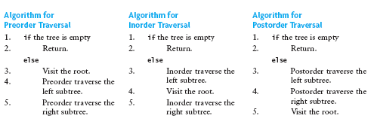
BST Traversals: Inorder
25
Strategy
Visit Left Subtree
Visit Root
Visit Right Subtree
12
51
5
14
2
6
2, 5, 6, 12, 14, 25, 51
Notes:
Data structures are ways to collect data. There are basic categories of data structures:

Slide 51
BST Traversals: Inorder
25
Strategy
Visit Left Subtree
Visit Root
Visit Right Subtree
12
51
5
14
2
6
Notes:
Data structures are ways to collect data. There are basic categories of data structures:

Slide 52
Binary Search Tree: C++ Inorder Traversal
class TreeNode
{
public:
int val;
TreeNode *left;
TreeNode *right;
TreeNode(int x) : val(x), left(nullptr), right(nullptr) {}
};
void inorder(TreeNode* head)
{
if(head == nullptr)
cout << "";
else
{
inorder(head->left);
cout << head->val << " ";
inorder(head->right);
}
}
https://onlinegdb.com/BygDgQCjI
Notes:
Track of progress, access to current and mechanism to next data element
Dereference operator to get the data

Slide 53
BST Traversals: Preorder
25
Strategy
Visit Root
Visit Left Subtree
Visit Right Subtree
12
51
5
14
2
6
Notes:
Data structures are ways to collect data. There are basic categories of data structures:

Slide 54
BST Traversals: Preorder
25
Strategy
Visit Root
Visit Left Subtree
Visit Right Subtree
12
51
5
14
2
6
25, 12, 5, 2, 6, 14, 51
Notes:
Data structures are ways to collect data. There are basic categories of data structures:

Slide 55
BST Traversals: Postorder
25
Strategy
Visit Left Subtree
Visit Right Subtree
Visit Root
12
51
5
14
2
6
Notes:
Data structures are ways to collect data. There are basic categories of data structures:

Slide 56
BST Traversals: Postorder
25
Strategy
Visit Left Subtree
Visit Right Subtree
Visit Root
12
51
5
14
2
6
2, 6, 5, 14, 12, 51, 25
Notes:
Data structures are ways to collect data. There are basic categories of data structures:

Slide 57
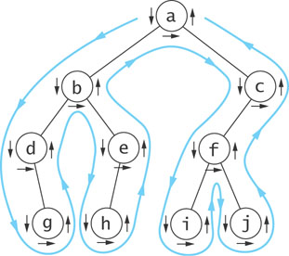
BST Traversals: Euler Tour
Visiting each node in the tree
Depth First Strategy
Preorder (down arrow)
Inorder (horizontal arrow)
Postorder (up arrow)
Notes:
Data structures are ways to collect data. There are basic categories of data structures:

Slide 58
BST Traversals: Level Order
25
Strategy
Traverse all nodes in Level 0 upto n-1
12
51
5
14
2
6
25, 12, 51, 5, 14, 2, 6
Notes:
Data structures are ways to collect data. There are basic categories of data structures:

Slide 59
Use Cases of Traversal
Notes:
Hi everyone, welcome to the second module of the course

Slide 60
Binary Tree: Sum of Right Leaves
Notes:
Track of progress, access to current and mechanism to next data element
Dereference operator to get the data

Slide 61
Binary Tree: Sum of Right Leaves
void sumOfRightLeaves(TreeNode* root)
{
queue<TreeNode*> q;
int sum = 0;
if(root != NULL)
q.push(root);
while (!q.empty())
{
if (q.front()->right != NULL && q.front()->right->right == NULL && q.front()->right->left == NULL)
sum += q.front()->right->val;
if (q.front()->left != NULL)
q.push(q.front()->left);
if (q.front()->right != NULL)
q.push(q.front()->right);
q.pop();
}
cout << sum;
}
Notes:
Track of progress, access to current and mechanism to next data element
Dereference operator to get the data

Slide 62
Binary Tree: Sum of Right Leaves
void sumOfRightLeaves(TreeNode* root)
{
queue<TreeNode*> q;
int sum = 0;
if(root != NULL)
q.push(root);
while (!q.empty())
{
if (q.front()->right != NULL && q.front()->right->right == NULL && q.front()->right->left == NULL)
sum += q.front()->right->val;
if (q.front()->left != NULL)
q.push(q.front()->left);
if (q.front()->right != NULL)
q.push(q.front()->right);
q.pop();
}
cout << sum;
}
Notes:
Track of progress, access to current and mechanism to next data element
Dereference operator to get the data

Slide 63
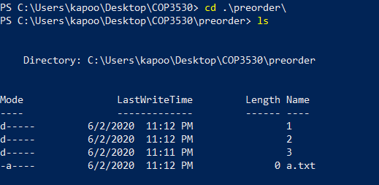
Trees Traversal: Use Cases
Preorder Traversal
Printing Directory Listings
preorder
1
2
3
a.txt
b.txt
c.txt
d.txt
https://sp19.datastructur.es/
Notes:
Data structures are ways to collect data. There are basic categories of data structures:

Slide 64
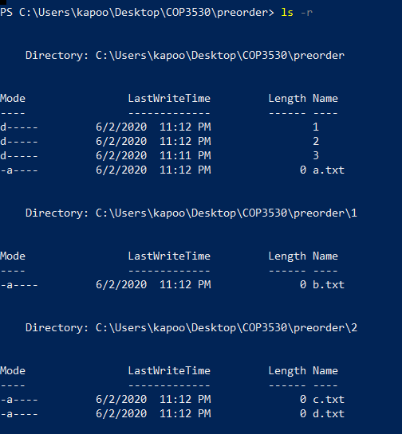
Trees Traversal: Use Cases
Preorder Traversal
Printing Directory Listings
preorder
1
2
3
a.txt
b.txt
c.txt
d.txt
https://sp19.datastructur.es/
Notes:
Data structures are ways to collect data. There are basic categories of data structures:

Slide 65
Trees Traversal: Use Cases
Preorder Traversal
Printing Directory Listings
preorder
preorder/
1/
b.txt
2/
c.txt
d.txt
3/
a.txt
1
2
3
a.txt
b.txt
c.txt
d.txt
https://sp19.datastructur.es/
Notes:
Data structures are ways to collect data. There are basic categories of data structures:

Slide 66
Trees Traversal: Use Cases
Postorder Traversal
Gathering File Sizes
postorder
1/
100
2/
200
300
3/
500
postorder/
1
2
3
a.txt
500
b.txt
c.txt
d.txt
200
300
100
https://sp19.datastructur.es/
Notes:
Data structures are ways to collect data. There are basic categories of data structures:

Slide 67
Trees Traversal: Use Cases
Postorder Traversal
Gathering File Sizes
postorder
500
0
500
1/
100
2/
200
300
3/
500
postorder/
1
2
3
a.txt
100
500
b.txt
c.txt
d.txt
200
300
100
https://sp19.datastructur.es/
Notes:
Data structures are ways to collect data. There are basic categories of data structures:

Slide 68
Trees Traversal: Use Cases
1100
Postorder Traversal
Gathering File Sizes
postorder
500
0
500
1/
100
2/
200
300
3/
500
postorder/
1
2
3
a.txt
100
500
b.txt
c.txt
d.txt
200
300
100
https://sp19.datastructur.es/
Notes:
Data structures are ways to collect data. There are basic categories of data structures:

Slide 69
Binary Search Tree: Size of directories
class TreeNode {
public:
int size;
char name;
TreeNode *left;
TreeNode *right;
TreeNode(char n, int s) : size(s), name(n), left(nullptr), right(nullptr) {}
};
int postOrder(TreeNode* head)
{
if(head == NULL)
return 0;
int total = 0;
total += postOrder(head->left);
total += postOrder(head->right);
total += head -> size;
return total;
}
https://onlinegdb.com/_zZnXu1X5u
Notes:
Track of progress, access to current and mechanism to next data element
Dereference operator to get the data

Slide 70
Trees Traversal: Other Use Cases
Postorder Traversal
Managing memory when deleting a tree
Preorder Traversal
Creating a copy of a tree
Notes:
Data structures are ways to collect data. There are basic categories of data structures:

Slide 71
Mentimeter
Notes:
Array of Strings

Slide 72
Questions

Slide 73
Mentimeter
1. The maximum height of a BST with 5 nodes can be? (Assume height is 1-based, i.e. if there is one node in the tree, the root, height is 1).
Notes:
Array of Strings

Slide 74
Mentimeter
2. The minimum height of a BST with 5 nodes is? (Assume height is 1-based, i.e., if there is one node in the tree, the root, height is 1).
Notes:
Array of Strings

Slide 75
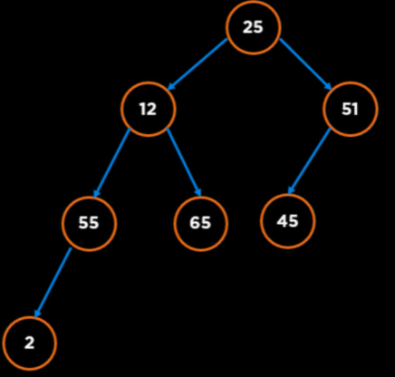
Mentimeter
3. The inorder predecessor of the node 25 in this tree is node _?
Notes:
Array of Strings

Slide 76
Mentimeter
4. The maximum number of Nodes in a 5-ary Tree of height 4 is? (Assume height is 1-based, i.e., if there is one node in the tree, the root, height is 1).
Notes:
Array of Strings

Slide 77
Mentimeter
4. The maximum number of Nodes in a 5-ary Tree of height 4 is? (Assume height is 1-based, i.e., if there is one node in the tree, the root, height is 1).
In graph theory, an m-ary tree (also known as k-ary or k-way tree) is a rooted tree in which each node has no more than m children. A binary tree is the special case where m = 2.
The total number of nodes, N in a perfect m-ary tree is (height is 0 based):
$$N=\frac{m^{h+1}−1}{m−1}$$
https://en.wikipedia.org/wiki/M-ary_tree
Notes:
Array of Strings

Slide 78
Mentimeter
5. What is the computational complexity of searching an item in a binary search tree?
Notes:
Array of Strings

Slide 79
Mentimeter
6. What is the computational complexity of searching an item in a binary search tree in the average case?
Notes:
Array of Strings

Slide 80
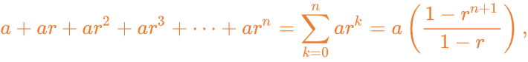
Mentimeter
6. The maximum number of Nodes in a 6-ary Tree of height 3 is? (Assume height is 1-based, i.e. if there is one node in the tree, the root, height is 1).
The total number of nodes, N in a perfect m-ary tree is (height is 0 based):
$$N=\frac{m^{h+1}−1}{m−1}$$
From GP:
https://en.wikipedia.org/wiki/M-ary_tree
Notes:
Array of Strings

Slide 81
Mentimeter
Level order Traversal:
25, 12, 51, 55, 65, 45, 2
GatorLevel Traversal
25, 51, 12, 55, 65, 45, 2
Notes:
Array of Strings

Slide 82
n-Ary Tree: Level Order Traversal
01 02 03 04 05 06 07 08 09 10 11 12 13 14 15 16 17 18 19 20 21 22 23
void levelOrder(Node* root) { int level = 1; queue<Node*> q; q.push(root); while (!q.empty()) { vector<int> vec; int size = q.size(); for (int i = 0; i < size; i++) { Node* temp = q.front(); vec.push_back(temp->val); q.pop(); for (auto element : temp->children) q.push(element); } cout << "Level: " << level++ << endl; for (int i = 0; i < vec.size(); i++ ) cout << vec[i] << " "; cout << endl; } }
Notes:
Track of progress, access to current and mechanism to next data element
Dereference operator to get the data

Slide 83
More Properties Related to Height
Notes:
Hi everyone, welcome to the second module of the course

Slide 84
Trees: Terminology
Height
The height of a tree is the number of nodes in the longest path from the root node to a leaf node
25
Height = 3
If tree has just the root,
Height = 1
2
51
If tree has more nodes than the root,
Height = 1 + max(Height(children))
14
65
Notes:
Data structures are ways to collect data. There are basic categories of data structures:

Slide 85
Trees: Terminology
Height of a Node
The height of a node is the number of nodes in the longest path from the node to a leaf node
25
Height (25) = 3
Height (2) = 1
2
51
14
65
Height (14) = 1
Notes:
Data structures are ways to collect data. There are basic categories of data structures:

Slide 86
Trees: Relationship between Height and Number of Nodes
Minimum number of Nodes in a Tree with Height, h
Notes:
Data structures are ways to collect data. There are basic categories of data structures:

Slide 87
Trees: Relationship between Height and Number of Nodes
Minimum number of Nodes in a Tree with Height, h
If height = h, at least one node at each level, therefore
Number of Nodes, n = h
Height, h = 3
25
Spindly Tree
51
65
Notes:
Data structures are ways to collect data. There are basic categories of data structures:

Slide 88
Trees: Relationship between Height and Number of Nodes
Maximum number of Nodes in a Tree with Height, h
Notes:
Data structures are ways to collect data. There are basic categories of data structures:

Slide 89
Trees: Relationship between Height and Number of Nodes
Maximum number of Nodes in a Tree with Height, h
If height = h, all possible node at each level, therefore
Number of Nodes, n = 1 + 2 + 4 + … + 2^{h-1} = 2^{h} - 1
25
Height, h = 3
Perfect Binary Tree
Bushy Tree
2
51
https://en.wikipedia.org/wiki/1_%2B_2_%2B_4_%2B_8_%2B_%E2%8B%AF
5
11
14
65
Notes:
Data structures are ways to collect data. There are basic categories of data structures:

Slide 90
Trees: Relationship between Height and Number of Nodes
Number of Nodes is between h and 2^{h} - 1
h <= n <= 2^{h} - 1
n + 1 <= 2^{h}
log (n + 1) <= log (2^{h} )
log (n + 1) <= log (2^{h} )
log (n + 1) <= h
Height of a Tree, h is between log₂ (n+1) and n
Notes:
Data structures are ways to collect data. There are basic categories of data structures:

Slide 91
Trees Height: Takeaway
Trees with n nodes can have a height that is proportional to n or proportional to log (n).
For good performance we want a tree that is as perfect as possible or as “bushy” as possible, i.e. height ~ log (n)
Notes:
Data structures are ways to collect data. There are basic categories of data structures:

Slide 92
BST Performance
Notes:
Hi everyone, welcome to the second module of the course

Slide 93
BST Insertion
n! different ways to insert n elements
25
65
51
85
51
65
91
85
25
91
Notes:
Data structures are ways to collect data. There are basic categories of data structures:

Slide 94
BST Insert, Delete and Search
Worst Case ~ Height = n
And Common Operations will be O(n)
25
51
65
85
91
Notes:
Data structures are ways to collect data. There are basic categories of data structures:

Slide 95
BST Insert, Delete and Search
Average Case ~ Height = log n
And Common Operations will be O(log n)
25
2
51
5
11
65
Reed, 2003: http://citeseerx.ist.psu.edu/viewdoc/download?doi=10.1.1.152.1289&rep=rep1&type=pdf
Notes:
Data structures are ways to collect data. There are basic categories of data structures:

Slide 96
BST Insert, Delete and Search
Best Case ~ Height = log n
And Common Operations will be O(log n)
25
2
51
5
11
65
Notes:
Data structures are ways to collect data. There are basic categories of data structures:

Slide 97
How do we fix the Worst Case?
Never add new leaves at the bottom: Increase size of node
Transform the “Spindly” Tree to “Bushy Tree” using Tools and Algorithms
25
51
65
85
91
Notes:
Data structures are ways to collect data. There are basic categories of data structures:

Slide 98
Questions

